Slide 1
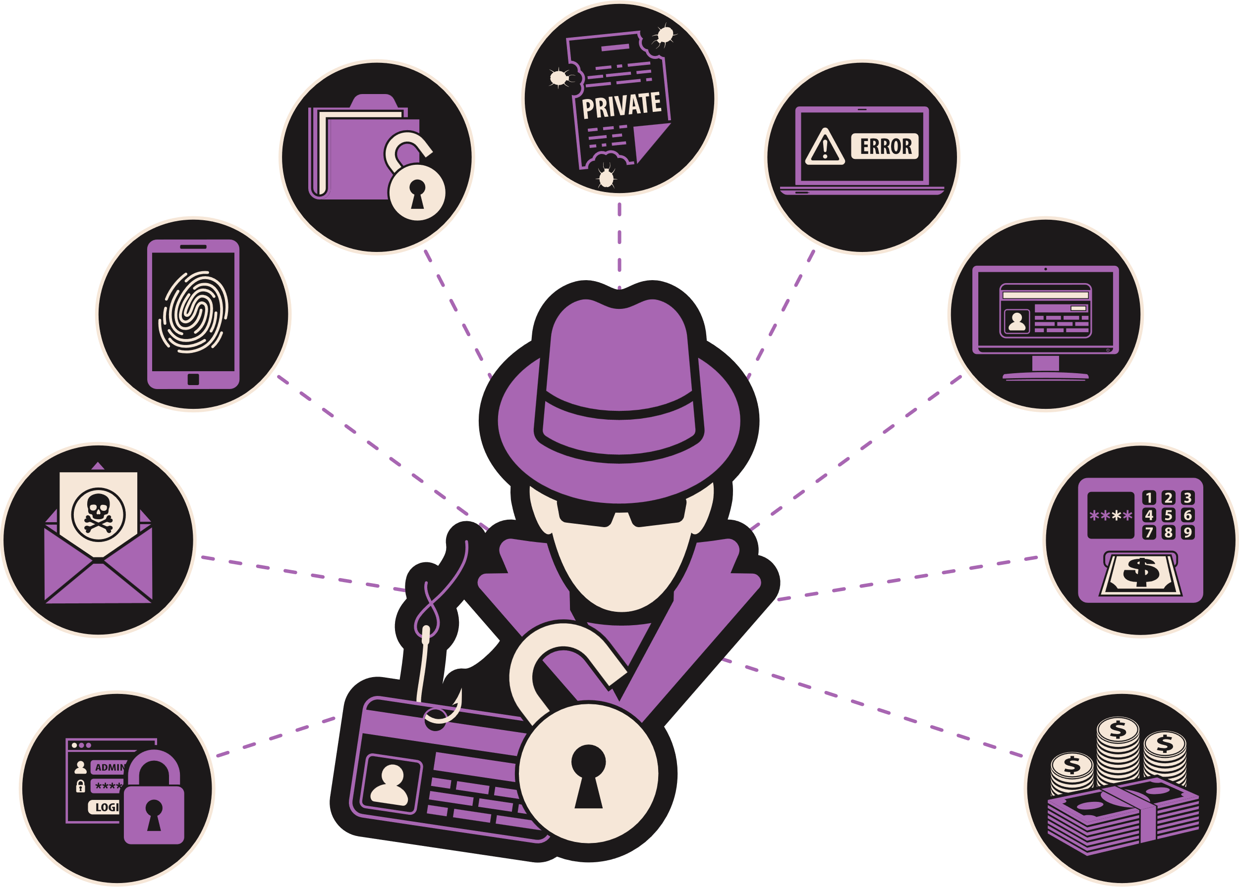
PHISHING
Think Twice Before You Click!
Made By Ali Boussaksou

Slide 2
OBJECTIVES
By the end of this lesson, students will be able to:
1
2
3
Define phishing and identify common methods used by scammers
Recognize red flags in phishing emails, messages, or posts
Develop critical thinking skills to discern legitimate requests from potential phishing attempts

Slide 3
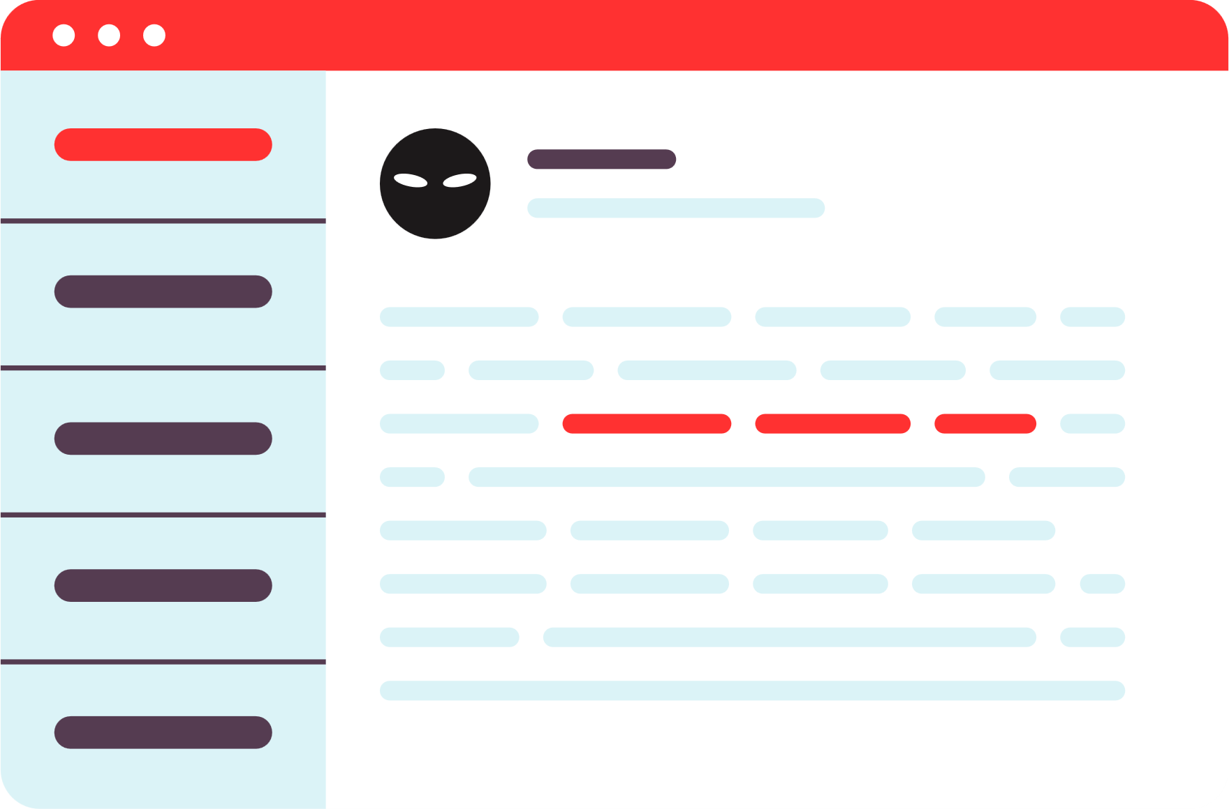
WHAT IS PHISHING?
Phishing is a cyberattack where fraudsters deceive people into revealing sensitive information like passwords, bank details, or personal data by pretending to be trusted sources.
This is often done to gain unauthorized access to accounts, steal identities, or commit financial fraud.
Think of an email or message you received that asked for personal information. What made it suspicious?

Slide 4



TYPES OF PHISHING
Phishing attacks come in different forms
EMAIL PHISHING
SMS PHISHING
SOCIAL MEDIA PHISHING
Scammers send deceptive emails posing as a reputable organization
Scammers send texts containing fake links or requests for personal details
Scammers make fake profiles or posts to deceive you into clicking links or providing personal information.

Slide 5

RED FLAGS
Red flags in phishing attempts are warning signs that help people spot potential scams. Common red flags include:
1
Urgent or threatening language
2
Suspicious sender information
3
Requests for personal information
4
Misspellings or grammatical errors
5
Suspicious links or attachments
6
Generic greetings
7
Too good to be true

Slide 6

01
URGENT OR THREATENING LANGUAGE
03
REQUESTS FOR PERSONAL INFORMATION
Phishing attempts often create a sense of urgency or use threatening language to prompt immediate action. Phases like "urgent action required," "account suspended," or "your account will be deleted" may indicate a phishing attempt.
Legitimate organizations do not request personal information, such as usernames, passwords, or credit card numbers, via email, social media, or other online means. Be cautious of any request for personal information.
02
SUSPICIOUS SENDER INFORMATION
04
MISSPELLINGS OR GRAMMATICAL ERRORS
Check the sender's email address or social media profile. Phishing emails or messages often use generic or suspicious email addresses that do not match the legitimate entity they claim to represent.
Phishing emails or messages may contain misspellings, grammatical errors, or awkward phrasing. Legitimate organizations usually have professional communications and do not contain obvious errors.

Slide 7
05
SUSPICIOUS LINKS OR ATTACHMENTS
07
TOO GOOD TO BE TRUE
Be cautious of links or attachments in emails or messages from unknown or untrusted sources. Hover over links to check their actual destinations, and do not click on suspicious links or download attachments that you were not expecting.
Phishing attempts may lure individuals with enticing offers, such as winning a prize or getting a huge discount. If an offer seems too good to be true, it may be a phishing attempt.
06
GENERIC GREETINGS
Which of the seven red flags do you think is the hardest to detect? What makes you say that?
Phishing emails may use generic greetings like "Dear Customer" instead of addressing you by your name. Legitimate organizations often personalize their communications with your name or other relevant information.

Slide 8
CONSIDER THESE RED FLAGS
EXAMPLE 1
You come across a pop-up window while browsing a website that asks you for your credit card information to claim a prize or discount within the next 10 minutes. The website looks legitimate, but you only have 10 minutes to submit your personal information.
EXAMPLE 2
Read the examples and then identify which form of phishing it is and what red flags make it a phishing attempt.
You receive a message on social media from someone claiming to be a friend or family member, asking for your address and phone number. You've never met this person and don't see photos of them with your family or friends.

Slide 9

REPORT PHISHING ATTEMPTS
If you believe you've encountered a phishing attempt, inform a trusted adult, teacher, or your school's IT department. Avoid forwarding the phishing email or message, as doing so might expose others to the scam. Instead, show the suspicious message directly on your device.
Reporting phishing attempts helps protect others from falling victim to the scam.

Slide 10



THINK CRITICALLY
Be skeptical of emails, messages, or posts that seem too good to be true or too urgent. Remember, if it sounds too good to be true, it probably is!
Think before clicking on any links, sharing personal information online, or opening any suspicious attachments. Ask yourself if it seems legitimate and if you were expecting it.
Verify the authenticity of the sender and the information provided before taking any action. Trust your instincts and be cautious when sharing information online.

Slide 11
THINK BEFORE YOU CLICK!
PROTECT YOURSELF FROM PHISHING
Don't share your personal information online!

Slide 12


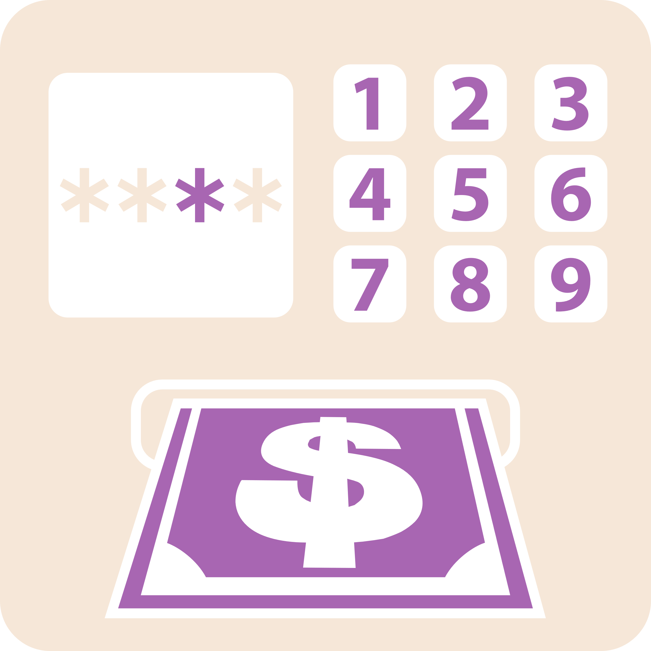


RESOURCES

